Slide 1
-
AMERICAN INTERNATIONAL UNIVERSITY-BANGLADESH
FACULTY OF ENGINEERING
DEPARTMENT OF Electrical & Electronic Engineering (EEE)
COURSE: DIGITAL LOGIC & CIRCUITS
SECTION: F
Supervised By: RUBAB AHMMED
WELCOME
ASSIGNMENT NAME: Digital Parking Control System.
Name | ID
MD. SADAT HOSSAIN | 23-54928-3

Slide 2



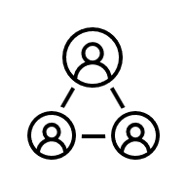



Table Of Contents
Introduction
System Design Overview
Digital Logic Design (Part i)
555 Timer Circuits (Part ii)
FSM Design with Verilog (Part iii)
Analysis & Improvements (Part iv)
Conclusion

Slide 3
Introduction:
This project designs a Digital Parking Control System to monitor parking space availability for up to 8 cars (based on Student ID 23-54928-3). The system counts vehicles using entry/exit sensors and displays "FULL" (continuous) or "SPACE AVAILABLE" (blinking) on seven-segment displays.
The design is presented in four parts: (i) Digital logic diagrams and counter design. (ii) 555 timer circuits for display control. (iii) Finite State Machine with Verilog code. (iv) Analysis, limitations, and improvements.

Slide 4
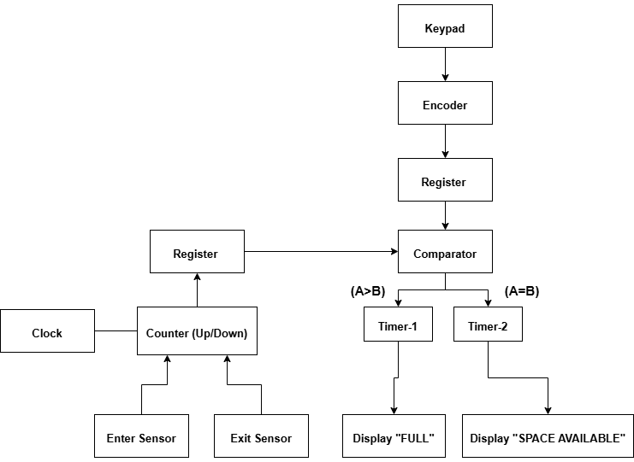
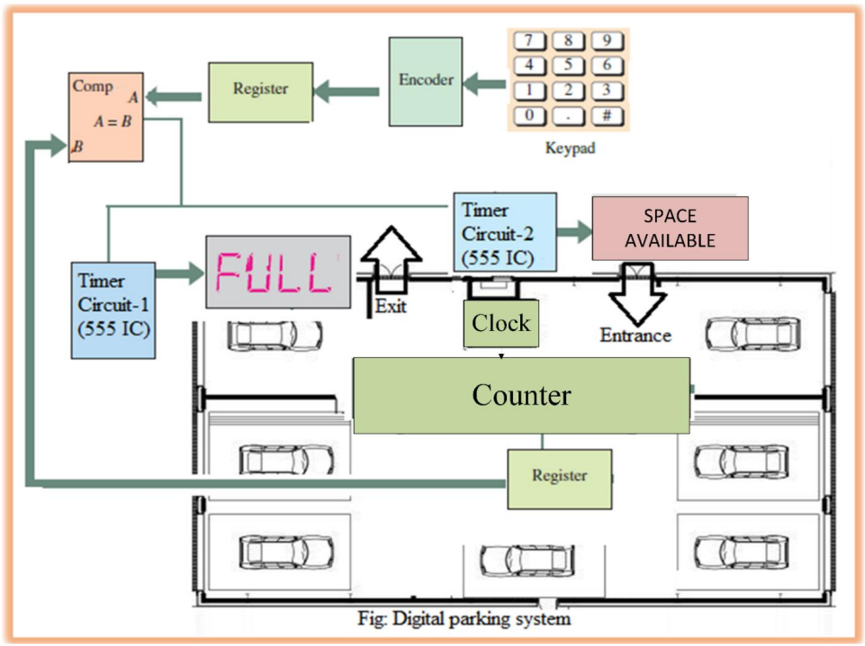
-
System Design Overview:
-

Slide 5
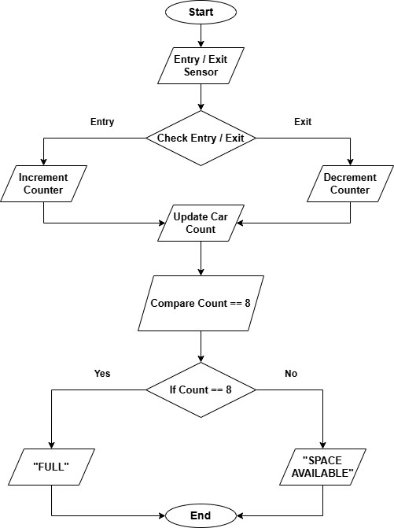
Digital Logic Design (Part i):
Essential Steps:
Input: Keypad (max=8) + Sensors (entry/exit) → Filtering
Counting: Up/down counter (increment if count<8, decrement if count>0)
Detection: Comparator (count=8 → FULL=1)
Output: FULL=1 → Timer-1 ("FULL"), FULL=0 → Timer-2 ("SPACE AVAILABLE")

Slide 6
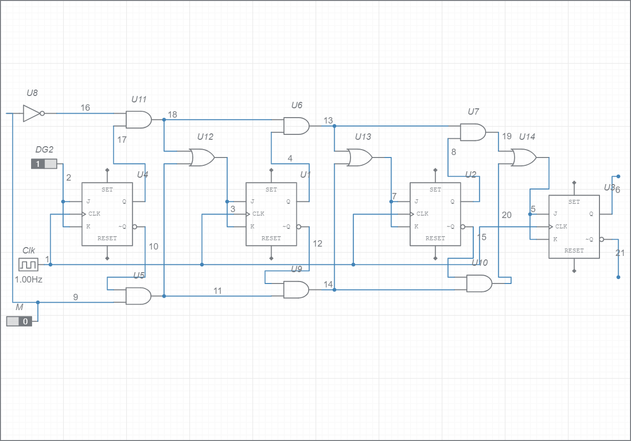
Digital Logic Design (Part i):
Purpose: Tracks car count (0-8) by incrementing on entry, decrementing on exit.
Components:
4 JK flip-flops (store 4-bit binary count)
Control logic (AND/OR gates for enable/direction)
Common clock (synchronous operation)
JK Flip-Flop Configuration:
Each JK flip-flop works as toggle:
J=K=1: Toggles state
J=K=0: Maintains state
Operation:
Entry + count<8: Counter increments (toggles bits per binary addition)
Exit + count>0: Counter decrements (toggles bits per binary subtraction)
-Prevents overflow/underflow

Slide 7
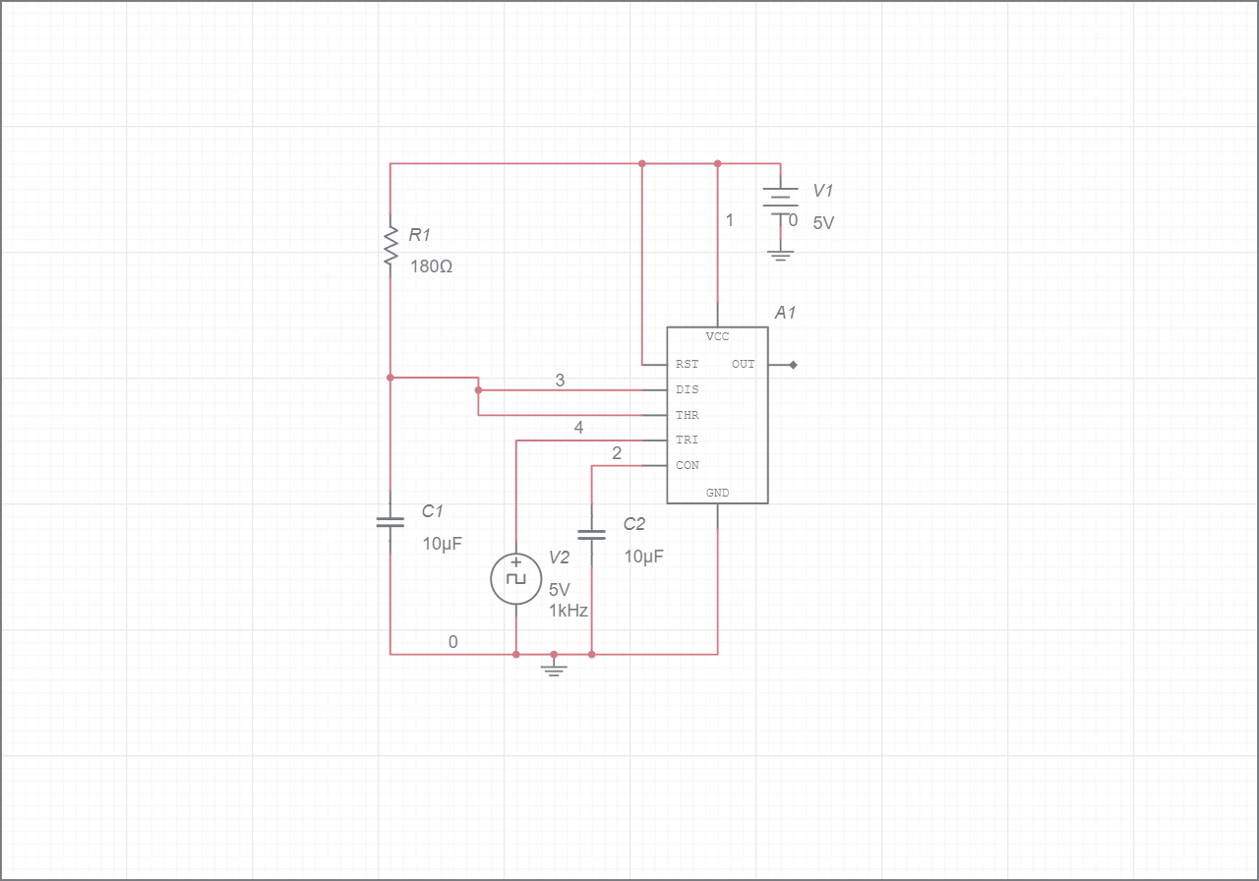
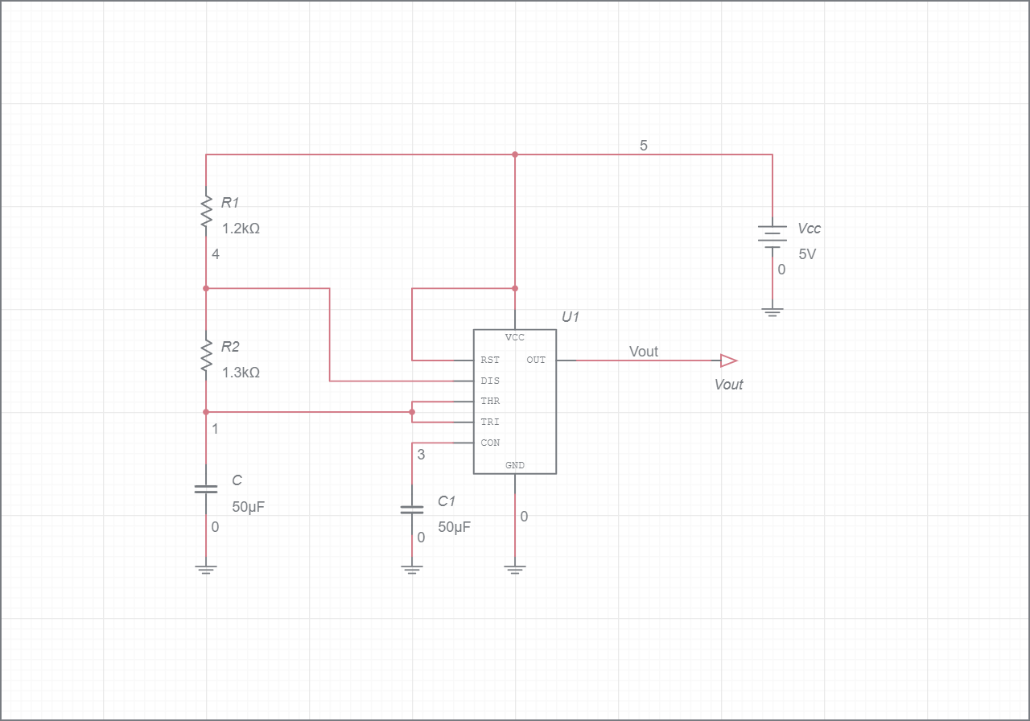
555 Timer Circuits (Part ii):
Timer-1: FULL Display (Continuous)
Configuration: Monostable (retriggerable)
Components: R=180Ω, C=10µF
Pulse width: 1.98 ms
Trigger: System clock (1 kHz)
Control: Reset pin (4) connected to FULL signal
Operation: Retriggers every 1 ms → continuous HIGH output
Timer-2: SPACE AVAILABLE Display (Blinking)
Configuration: Astable
Components: R₁=1.2kΩ, R₂=1.3kΩ, C=50µF
Duty cycle: 48% (calculated: D = 100 - P, P=52%)
Frequency: 11.54 Hz (target: 12 Hz)
ON time: 41.58 ms, OFF time: 45.05 ms
Control: Reset pin (4) connected to ¬FULL
Figure: Monostable
Figure: Astable

Slide 8
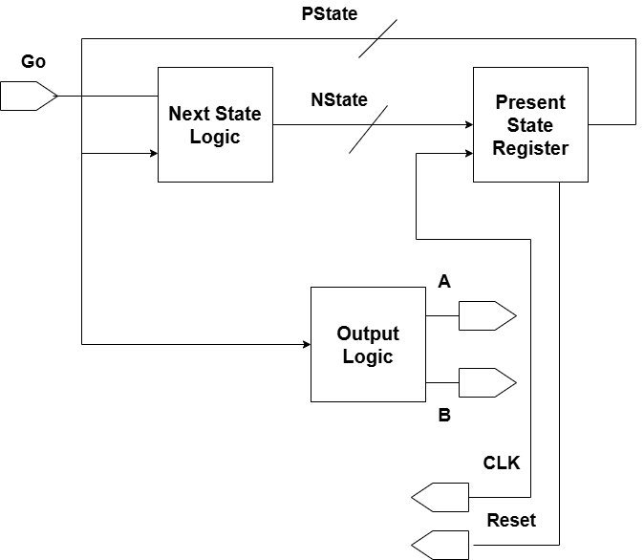
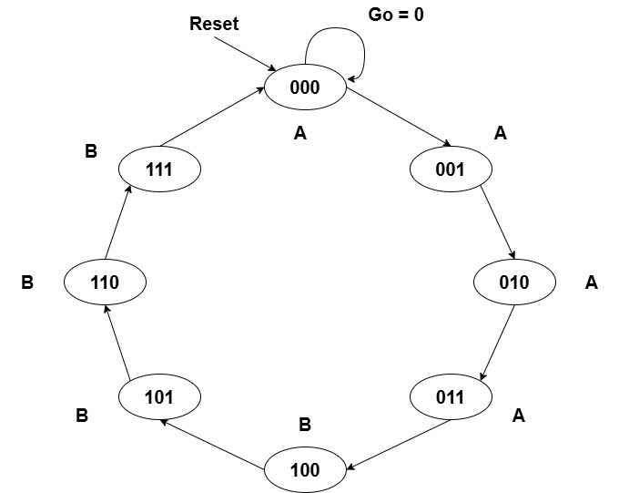
FSM Design With Verilog (Part iii):
Verilog HDL Code:
module ParkingFSM(input clk, rst, output reg A, B);
reg state, next_state;
reg [1:0] count, next_count;
parameter S0=0, S1=1;
always @(posedge clk or posedge rst) begin
if(rst) begin state<=S0; count<=0; end
else begin state<=next_state; count<=next_count; end
end
always @(*) begin
case(state)
S0: if(count==3) begin next_state=S1; next_count=0; end
else begin next_state=S0; next_count=count+1; end
S1: if(count==3) begin next_state=S0; next_count=0; end
else begin next_state=S1; next_count=count+1; end
endcase
end
always @(*) begin
case(state)
S0: {A,B}=2'b10;
S1: {A,B}=2'b01;
endcase
end
endmodule
FSM Specifications
Clock: 1 ms period (1 kHz)
TH: 4 ms (ON time for "SPACE AVAILABLE")
TL: 4 ms (OFF time for "SPACE AVAILABLE")
States: S0 (A=1,B=0), S1 (A=0,B=1)
Figure: FSM Design
Figure: State Diagram

Slide 9
Analysis & Improvement:
Drawbacks & Limitations
Part (i) - Digital Logic:
Limited capacity: 4-bit counter → max 15 cars
No memory: Power loss resets counter
Component-heavy: Multiple ICs required
Rigid design: Hard to modify
Part (ii) - 555 Timers:
Timing inaccuracy: ±10% error (analog)
Temperature sensitive: Drifts with temperature
Fixed parameters: Hardware changes needed
Power inefficient: Continuous current draw
Aspect | Current | Modified
Capacity | 8 cars | Unlimited
Accuracy | ±10% error | <1% error
Flexibility | Fixed | Programmable
Power | 50-100mA | <10mA
Maintenance | Hardware changes | Software updates
Modifications for Higher Capacity
Hardware Upgrades:
Increase counter size: 8-bit (255 cars) or 16-bit (65535 cars)
Add memory: EEPROM to save count during power loss
Use microcontroller: Replace discrete logic with µC
Replace 555 timers: Use µC PWM for display control

Slide 10
Conclusion:
Key Components Built-
Digital Logic System: 4-bit counter, comparator, and control logic.
Timer Circuits: Two 555 ICs for continuous and blinking displays.
Finite State Machine: Verilog-coded FSM for precise timing control.
Analysis & Improvements: Identified limits and proposed scalable upgrades.
Design Validated-
All requirements met for counting, display control, and timing.
System correctly shows "FULL" or blinking "SPACE AVAILABLE".
Architecture allows for future expansion to larger lots.
Future Steps-
Prototype the physical circuit.
Upgrade to a microcontroller for higher capacity and features.
The project successfully demonstrates a functional, scalable parking management system using core digital logic principles.
Thank You!

